Slide 1

AT Command Training
Steven Li
March, 2007

Slide 2

Agenda
AT Command Overview
Voice Call / CSD AT Command
GSM 07.07 AT Command
SMS AT Command
GPRS AT Command
AT Command Special for SIMCOM

Slide 3
Agenda
TCP/IP AT Command

Slide 4
Type of Extended AT Command
Test Command
AT+<X>=?
The mobile equipment returns the list of parameters and value ranges set with the corresponding Write command or by internal processes

Slide 5
Type of Extended AT Command
Read Command
AT+<X>?
This command returns the currently set value of the parameter or parameters.

Slide 6
Type of Extended AT Command
Set Command
AT+<X>=<…>
This command sets the user-definable parameter values.

Slide 7
Type of Extended AT Command
Execution Command
AT+<X>
The execution command reads non-variable parameters affected by internal processes in the GSM engine.

Slide 8
Commands according to GSM07.07
AT+CSQ
AT+CREG
AT+COPS
AT+CPIN
AT+CLCK
AT+CPWD

Slide 9
Commands according to GSM07.07
AT+CSQ Signal Quality Report
Test command AT+CSQ=? | Response +CSQ: (list of supported <rssi>s),(list of supported <ber>s)
Execute command AT+CSQ | Response +CSQ: <rssi>,<ber> +CME ERROR: <err> Execution command returns received signal strength indication <rssi> and channel bit error rate <ber> from the ME. Test command returns values supported by the TA.
 | Parameters <rssi>: 0 ‑113 dBm or less 1 ‑111 dBm 2...30 ‑109... ‑53 dBm 31 ‑51 dBm or greater 99 not known or not detectable <ber> (in percent): 0...7 as RXQUAL values in the table in GSM 05.08 [20] subclass 8.2.4 99 not known or not detectable
Reference GSM 07.07 [13] | Note

Slide 10
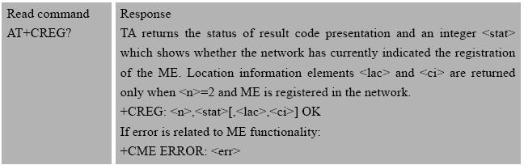
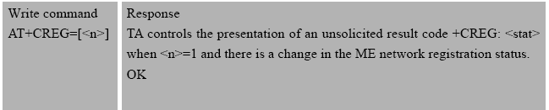
Commands according to GSM07.07
AT+CREG Network Registration

Slide 11
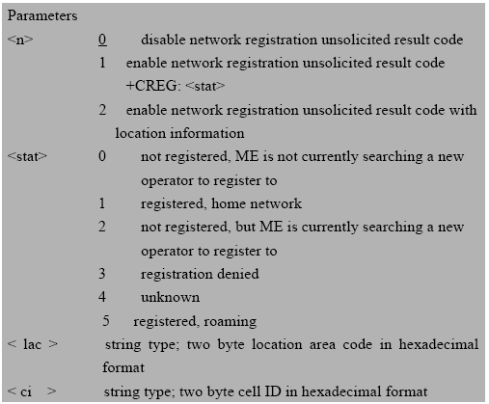
Commands according to GSM07.07
AT+CREG Network Registration
Example

Slide 12
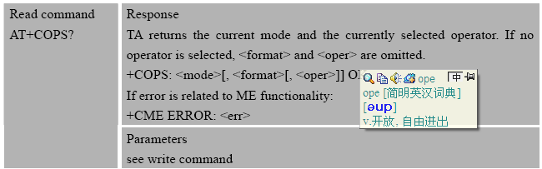
Commands according to GSM07.07
AT+COPS Operator Selection

Slide 13
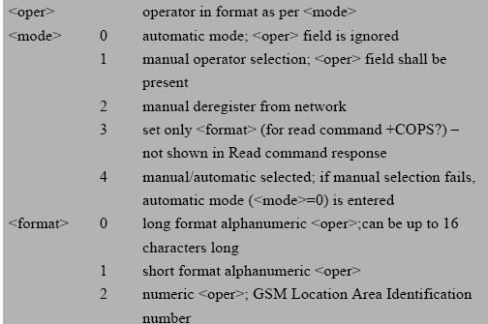
Commands according to GSM07.07
AT+COPS Operator Selection
Write Command
AT+COPS=<mode>,<format>,<oper>
Example

Slide 14
Commands according to GSM07.07
AT+CLCK Facility Lock
to lock phone to sim card, to lock sim card (PIN), etc
AT+CLCK=<fac>, <mode>, <passwd>
AT+CPWD Password Change
AT+CPWD=<fac>, <old passwd>, <new passwd>
AT+CPIN Enter Pin
AT+CPIN? to check whether some password is required or not
AT+CPIN=<passwd>

Slide 15
Commands according to GSM07.07
EXAMPLES
I have a sim card whose PIN number is 1234, and I want to lock it.
Restart the module, and check whether some password is required.
PIN number is needed.
I want to change the password from 1234 to 5678
Restart the module, and I need enter new PIN number this time.
I want to unlock the sim card, which means the next time the module restart, PIN number is not needed.

Slide 16
VOICE CALL / CSD
Execute command ATD[<n>][<mgsm][;] | Response This command can be used to set up outgoing voice, data or fax calls. It also serves to control supplementary services. Note: This command may be aborted generally by receiving an ATH command or a character during execution. The aborting is not possible during some states of connection establishment such as handshaking. If no dial tone and (parameter setting ATX2 or ATX4) NO DIALTONE If busy and (parameter setting ATX3 or ATX4) BUSY If a connection cannot be established NO CARRIER If connection successful and non-voice call. CONNECT<text> TA switches to data mode. Note: <text> output only if ATX<value> parameter setting with the <value> >0 When TA returns to command mode after call release OK If connection successful and voice call OK
 | Parameter <n> string of dialing digits and optionally V.25ter modifiers dialing digits: 0-9, * , #, +, A, B, C Following V.25ter modifiers are ignored: ,(comma), T, P, !, W, @ Emergency call: <n> Standardized emergency number 112(no SIM needed) <mgsm> string of GSM modifiers: I Actives CLIR (Disables presentation of own number to called party) i Deactivates CLIR (Enable presentation of own number to called party) G Activates Closed User Group invocation for this call only g Deactivates Closed User Group invocation for this call only <;> only required to set up voice call , return to command state

Slide 17
VOICE CALL / CSD
ATA
to answer an incoming call
ATH
to disconnect the existing connection
ATDL
to redial the last number

Slide 18
VOICE CALL / CSD
Set Command AT+CLIP=<n> | Response TA enables or disables the presentation of the CLI at the TE. It has no effect on the execution of the supplementary service CLIP in the network. OK If error is related to ME functionality: +CME ERROR: <err>
 | Parameters <n> 0 suppress unsolicited result codes 1 display unsolicited result codes <m> 0 CLIP not provisioned 1 CLIP provisioned 2 unknown
 | Unsolicited result code When the presentation of the CLI at the TE is enabled (and calling subscriber allows), an unsolicited result code is returned after every RING (or +CRING: <type>) at a mobile terminating call. +CLIP: <number>, <type>,<alphaId> Parameter <number> string type phone number of calling address in format specified by <type> <type> type of address octet in integer format; 145 when dialing string includes international access code character "+", otherwise 129 <alphaId> string type alphanumeric representation of <number> corresponding to the entry found in phone book

Slide 19
VOICE CALL / CSD
Set Command AT+COLP=[<n>] | Response TA enables or disables the presentation of the COL(Connected Line) at the TE for a mobile originated call. It has no effect on the execution of the supplementary service COLR in the network. Intermediate result code is returned from TA to TE before any +CR or V.25ter responses. OK
 | Parameters <n> (parameter sets/shows the result code presentation status in the TA): 0 disable 1 enable <m> (parameter shows the subscriber COLP service status in the network): 0 COLP not provisioned 1 COLP provisioned 2 unknown (e.g. no network, etc.)
 | Intermediate result code When enabled (and called subscriber allows), an intermediate result code is returned before any +CR or V.25ter responses: +COLP:<number>,<type>[,<subaddr>,<satype> [,<alpha>]]
 | Parameters <number> string type phone number of format specified by <type> <type> type of address octet in integer format; 145 when dialing string includes international access code character "+", otherwise 129 <subaddr> string type sub address of format specified by <satype> <satype> type of sub address octet in integer format (refer GSM 04.08 [8] sub clause 10.5.4.8) <alpha> optional string type alphanumeric representation of <number> corresponding to the entry found in phone book

Slide 20
VOICE CALL / CSD
EXAMPLES for
Outgoing a call
Disconnect a call
Answering a call
Presenting calling line number
Presenting a connected line number

Slide 21
SMS
Command | Description
AT+CMGD | DELETE SMS MESSAGE
AT+CMGF | SELECT SMS MESSAGE FORMAT
AT+CMGL | LIST SMS MESSAGES
AT+CMGR | READ SMS MESSAGE
AT+CMGS | SEND SMS MESSAGE
AT+CMGW | WRITE SMS MESSAGE TO MEMORY
AT+CMSS | SEND SMS MESSAGE FROM STORAGE
AT+CMGC | SEND SMS COMMAND
AT+CNMI | NEW SMS MESSAGE INDICATIONS
AT+CPMS | PREFERRED SMS MESSAGE STORAGE
AT+CRES | RESTORE SMS SETTINGS
AT+CSAS | SAVE SMS SETTINGS
AT+CSCA | SMS SERVICE CENTER ADDRESS
AT+CSCB | SELECT CELL BROADCAST SMS MESSAGES
AT+CSDH | SHOW SMS TEXT MODE PARAMETERS
AT+CSMP | SET SMS TEXT MODE PARAMETERS
AT+CSMS | SELECT MESSAGE SERVICE

Slide 22
SMS
Select SMS Message Format
AT+CMGF=0 PDU mode
AT+CMGF=1 TEXT mode
Select TE Character Set
AT+CSCS=? to list the supported characters “GSM”, “HEX”, “PCDN” etc.
Set SMS Service Centre Address
Shanghai +8613800210500
AT+CSCA=“+8613800210500”,145
Set SMS TEXT Mode Parameters
AT+CSMP

Slide 23
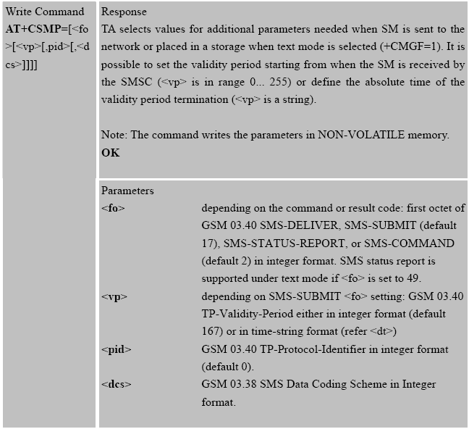
SMS

Slide 24
SMS
AT+CSMP=<fo>,<vp>,<pid>,<dcs>
to set SMS text mode parameters
<fo> default 17, and set as 49 to get SMS status report
<vp> period of validity, default 167
<pid> sending mode, default 0
<dcs> data coding scheme
Data coding scheme parameter
240 for GSM coding, and SM sent to the destination terminal directly
241 for GSM coding, and SM SIM card storage

Slide 25
SMS
AT+CNMI to set new SMS message indication with five parameters
<mode>, <mt> , <bm>, <ds> and <bfr> according to GSM 07.05
<ds> should be set to one if SMS status report is desired.
AT+CMGR=<index> to read the SMS
AT+CMGD=<index> to delete the SMS

Slide 26
SMS
EXAMPLES for sending an English short message in TEXT mode:
1. SMS Configuration
2. Sending Short Message in TEXT mode ( The content is “HELLO”. )
3. Reading message
4. Deleting message

Slide 27
GPRS AT Command
Command | Description
AT+CGDCONT | DEFINE PDP CONTEXT
AT+CGQMIN | QUALITY OF SERVICE PROFILE (MINIMUM ACCEPTABLE)
AT+CGQREQ | QUALITY OF SERVICE PROFILE (REQUESTED)
AT+CGACT | CONTEXT ACTIVATION
AT+CGDATA | ENTER DATA STATE
AT+CGATT | GPRS ATTACH OR DETACH
AT+CGPADDR | SHOW PDP ADDRESS
AT+CGCLASS | GPRS MOBILE STATION CLASS
AT+CGEREP | CONTROL UNSOLICITED GPRS EVENT REPORTING
AT+CGREG | NETWORK REGISTRATION STATUS
AT+CGSMS | SELECT SERVICE FOR MO SMS MESSAGES
AT+CGCOUNT | GPRS PACKET COUNTERS
GPRS Network Attach?

Slide 28
AT Command Special for SIMCOM
Up to 37 AT commands are special for SIMCOM, and you can
refer to the ATC datasheet for details.
Audio Concerned:
AT+CHFA to switch the audio channels
AT+CMIC to change the microphone gain level
AT+ECHO to control echo cancellation
AT+SIDET to change the side tone gain level

Slide 29
AT Command Special for SIMCOM
Others:
AT+CPOWD to turn off the module
AT+CPOWD=1<CR>
AT+IPR to set the baud rate of the communication serial port
AT+IPR=0 for auto baud rating
AT+IPR=<fixed rate> for fixed baud rate
AT+CSCLK to enable or disable slow clock function
The current consumption is reduced by 20mA in slow clock mode.
etc…

Slide 30
TCP/IP AT Command
SIMCom module products have built-in TCP/IP stack, and TCP/IP AT
commands are developed and implemented.
Both transparent mode and non-transparent mode are supported.
Modules can work as client and they can be configured as server either.

Slide 31
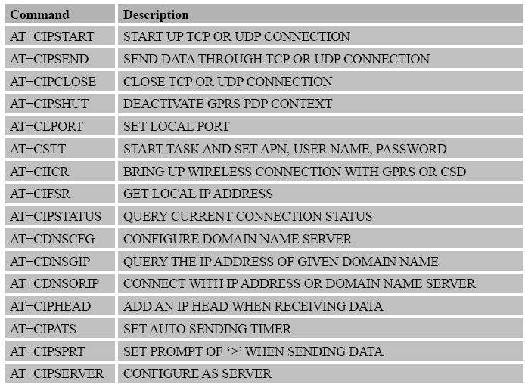
TCP/IP AT Command

Slide 32
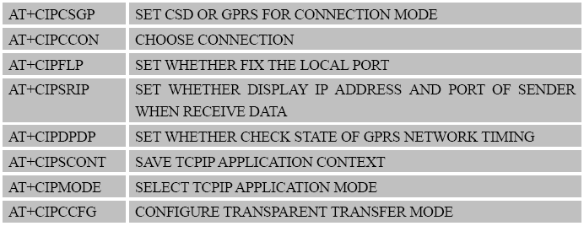
TCP/IP AT Command

Slide 33
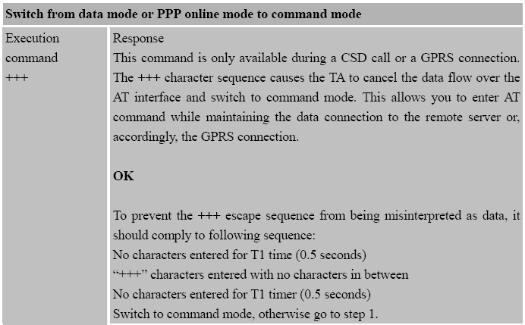
TCP/IP AT Command
These two commands can help you switch between data mode
and command mode in transparent mode.

Slide 34
TCP/IP AT Command
When using +++ sequence, you should remember:
There should be 500ms idle period both before and after the escaping sequence.
The interval between each + should be less than 20ms.
Only if the two conditions are met, the +++ will be considered as escaping sequence.
Otherwise, +++ will be dealt with data in transmission.
ATO to return to data mode

Slide 35
TCP/IP AT Command
AT+CSTT to start task and set APN, User Name, Password
AT+CSTT Start task and Set APN、USER NAME、PASSWORD
Test command +CSTT=? | Response +CSTT: "APN","USER","PWD" OK
Read command +CSTT? | Response +CSTT: <apn>,<user name>,<password> OK Parameter See write command
Write command +CSTT=<apn>,<user name>,<password> | Response OK ERROR Parameter <apn> a string parameter which indicates the GPRS access point name <user name> a string parameter which indicates the GPRS user name <password> a string parameter which indicates the GPRS password
Execution Command +CSTT | Response OK ERROR
Reference | Note
This command starts task internally, so you should use AT+CIPSHUT before the next connection.

Slide 36
TCP/IP AT Command
CMCC provides APN as CMNET.
Both the user name and password are null.
So we get,
AT+CSTT=“CMNET”,””,””

Slide 37
TCP/IP AT Command
AT+CIPSTART to start up TCP or UDP connection
AT+CIPSTART=<mode>, <IP address>, <port>
<mode> “TCP” or “UDP”
<IP address> remote server IP address
<port> remote server port

Slide 38
TCP/IP AT Command
AT+CIPSEND to send data through TCP or UDP connection
AT+CIPSEND<CR>
then you will see the prompt mark >
>XXXXXXXXXXXXXXXX (data to send up to 1024 bytes)
then terminate with Ctrl-z.
If connection has been established and sending is successful, you will see
SEND OK
You can also terminate with setting the data length or setting the time to send data automatically.
AT+CIPSEND=<length> or using AT+CIPAT

Slide 39
TCP/IP AT Command
AT+CIPMODE to select TCPIP application mode
AT+CIPMODE=<mode>
<mode>
0: normal mode (non-transparent mode)
1: transparent mode
AT+CIPSHUT to deactivate GPRS PDP context
AT+CIPSHUT<CR>
to shut off the current TCP or UDP connection

Slide 40
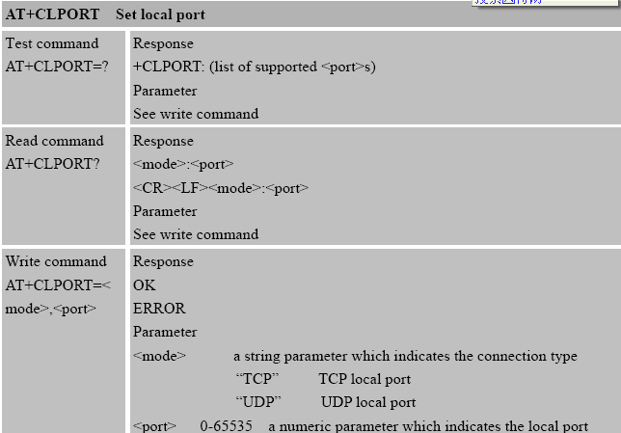
TCP/IP AT Command
AT+CLPORT

Slide 41
TCP/IP AT Command
AT+CIPSERVER Configure as a server
Read command +CIPSERVER? | Response <mode> OK Parameter <mode> 0 has not been configured as a server 1 has been configured as a server
Execution command +CIPSERVER | Response OK ERROR If configuration as server success, return: SERVER OK If configuration as server fail, return: STATE:<state> CONNECT FAIL Parameter <state> refer to AT+CIPSTART
Reference | Note

Slide 42
TCP/IP AT Command
EXAMPLES with two modules
Configure the module as a server.
Establish a TCP connection between the other module and the server module.
The client sends data “HELLO” to the server.
The server responses to the client “WORLD”.
Shut off this connection.

Slide 43
Thank you!
FOR MORE INFO, PLEASE REFER TO THE ATC DATASHEET.

